Slide 1
Programming Environment
Workshop 1

Slide 2
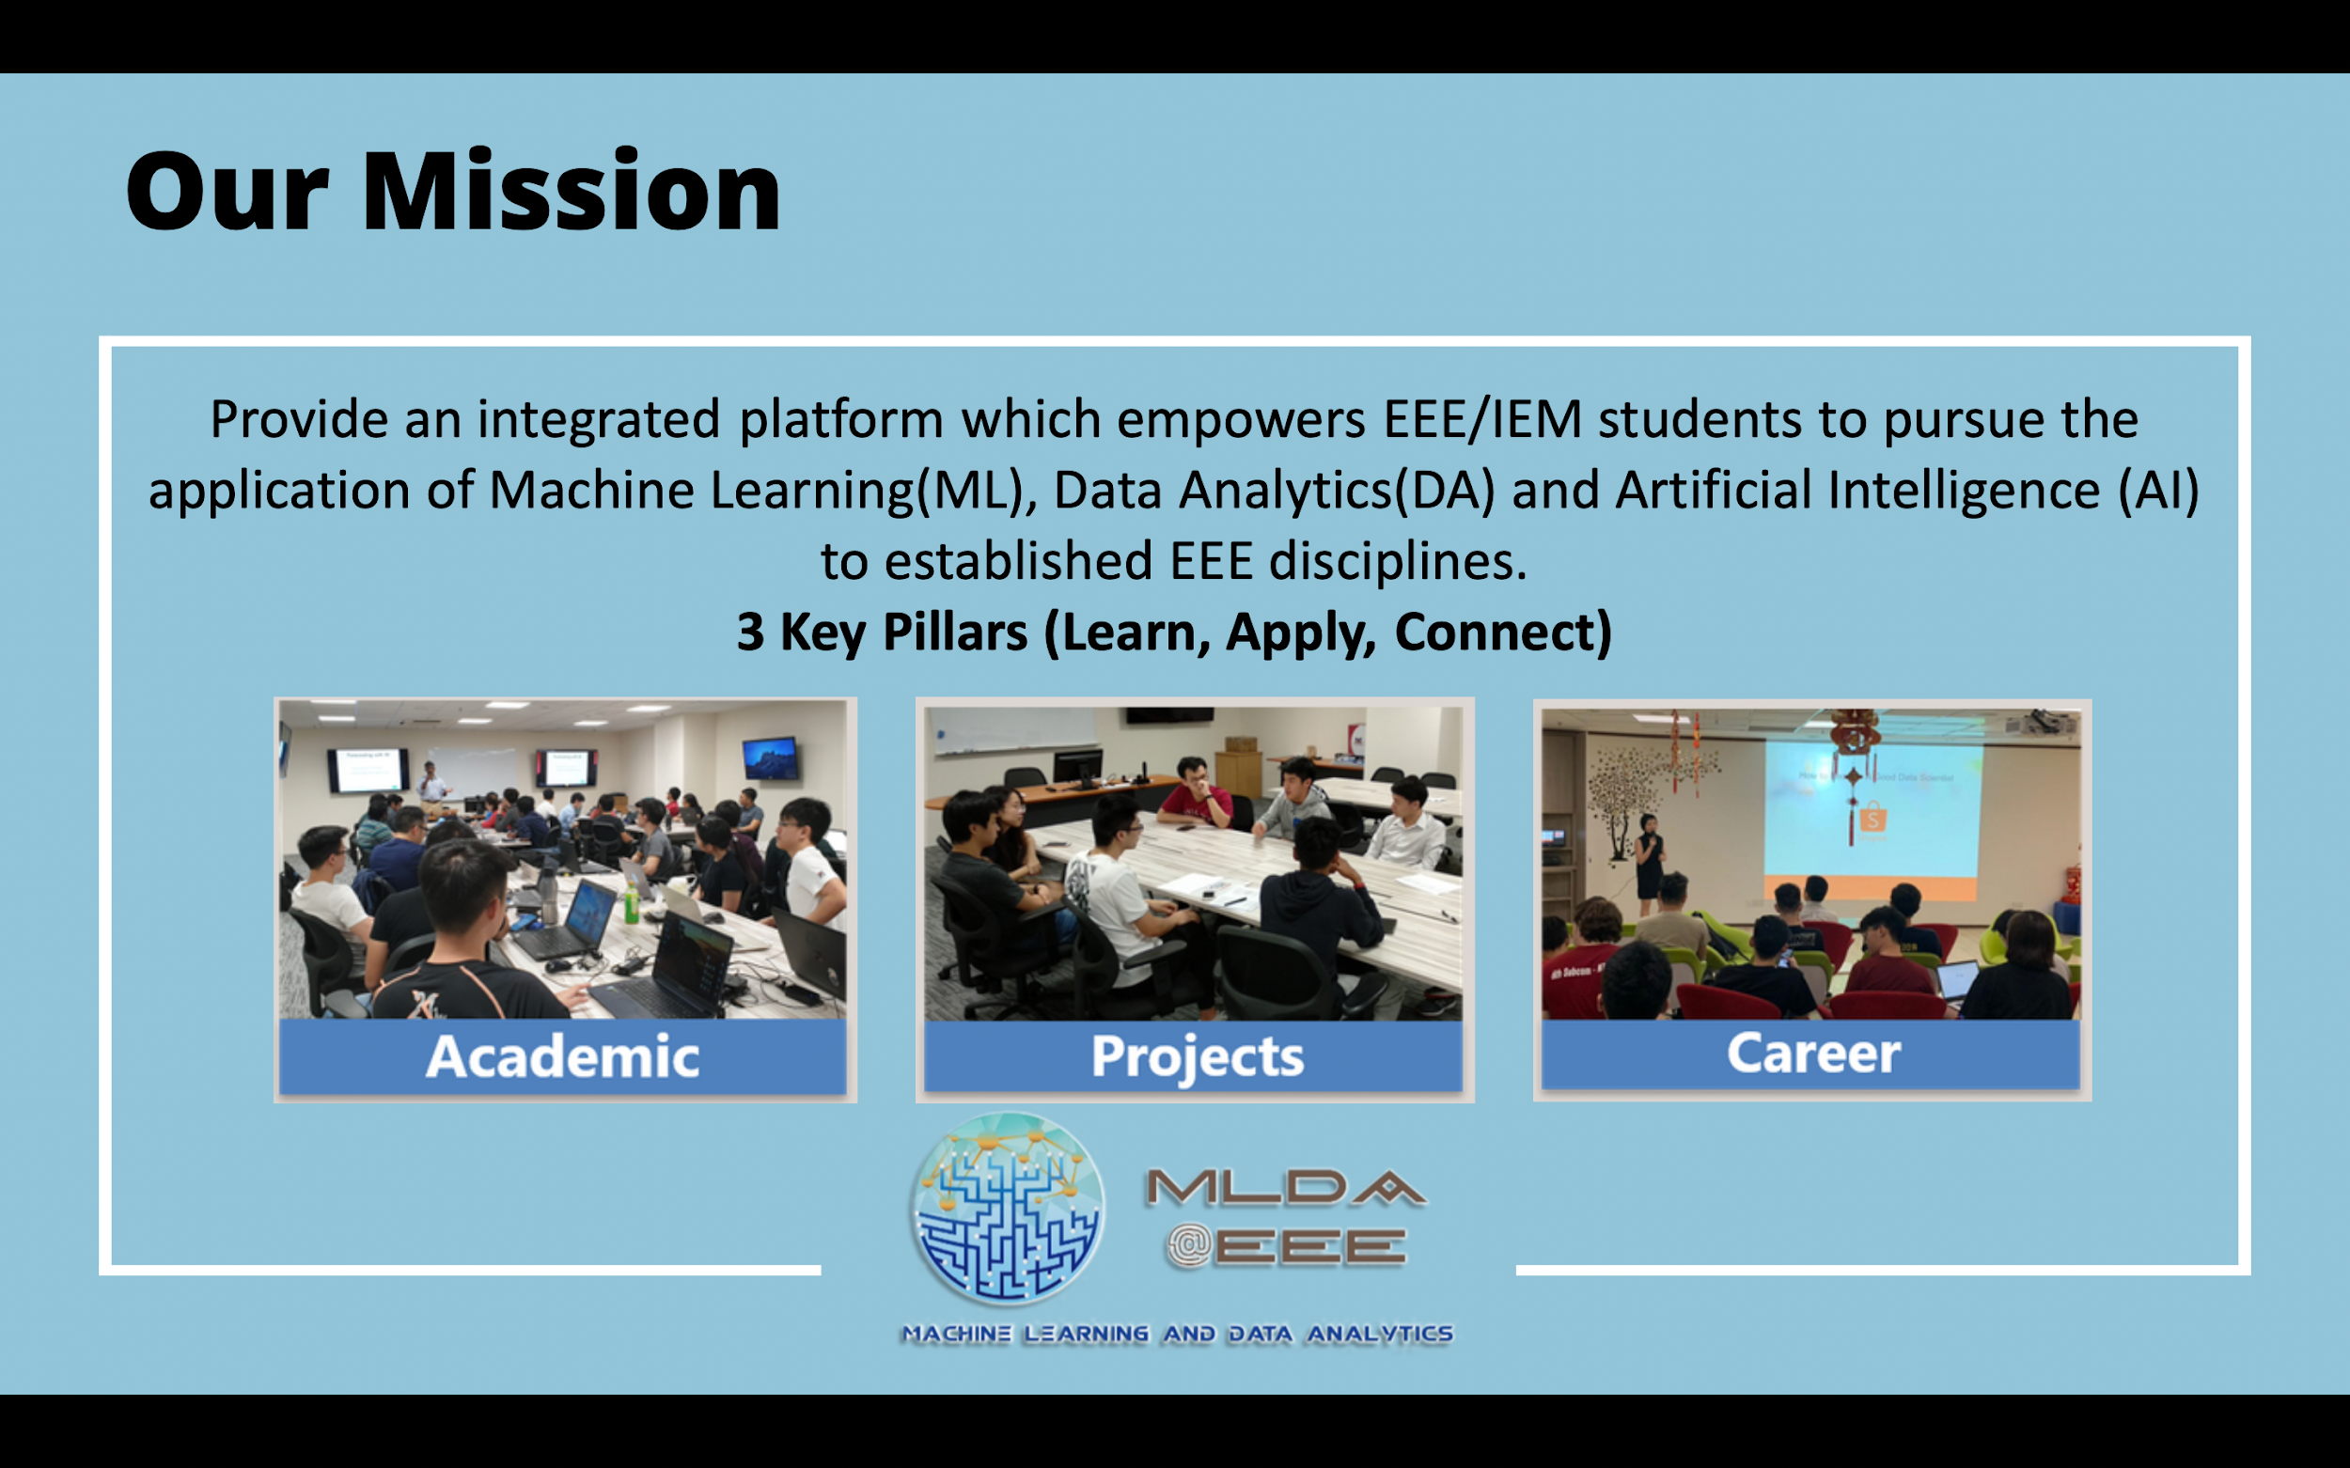
MLDA Introduction
LEARN
APPLY
CONNECT

Slide 3
Content
Integrated Development Environment (IDE)
VSCode
Python Environment
Anaconda, Conda
Python
Linux Environment
SSH
Remote Access GPU

Slide 4
IDE

Slide 5
IDE: VSCode
Cheatsheet: https://quickref.me/vscode
Suggestion, color highlighting
Library checker
Personalization
Rename variable
…
Extensions
Python (syntax)
CodeRunner

Slide 6
Python
From source: https://www.python.org/downloads/
.py
file
You write python file following a certain syntax
Python
A Program!
Where it is installed matters
Low-level, Computer code

Slide 7
Python libraries
A collection of .py files that define classes, functions with a specific utility
Libraries can depend on other libraries
Libraries install locations
Conda `/home/user/miniconda3/envs/env_name/lib/…`
Local
Linux: `/home/user/.local/`
Windows: `C:\Users\user\.AppData\local`

Slide 8
Where do libraries come from
Online repositories (PyPI, condaforge)
Lib3
Lib2
Lib1
pip, conda
Your computer

Slide 9
Python Package Management
Why do you need package management
A
v1
A
v1
B
v2
B
v1
C v1
C
v1
C
v2

Slide 10
Python Package Management
Why do you need package management
A
v1
A
v1
B
v2
B
v1
C v1
C
v1
C
v2

Slide 11
Environment Management
Default environment
Conda environment
base
env_1
env_2
python
python
python
python
lib
lib
lib
lib

Slide 12
Environment Management
Anaconda: https://www.anaconda.com/
Miniconda: https://docs.conda.io/projects/miniconda/en/latest/
Anaconda
Pre-installed with many libraries
GUI
Miniconda (installer)
Conda
Conda

Slide 13
Conda
Cheatsheet: https://docs.conda.io/projects/conda/en/latest/user-guide/cheatsheet.html
Create:
`conda create -n <env_name>`
`conda install <package_name>`
Read :
`conda activate <env_name>`
`conda env list`
`conda list`
`conda deactivate <env_name>`
Delete
`conda remove -n <env_name>`
`conda uninstall <package_name>`
Notice the `(base)` at the start

Slide 14
Pip
Cheatsheet: https://opensource.com/sites/default/files/gated-content/cheat_sheet_pip.pdf
Create
`pip install <pkg>`
Read :
`pip list`
`pip show`
Update:
`pip install <pkg> -u`
Delete
`pip uninstall <package_name>`

Slide 15
Linux, SSH

Slide 16
Linux
Cheatsheet: https://cheatography.com/davechild/cheat-sheets/linux-command-line/
Useful, basic command on directory
Create:
mkdir
Read:
pwd
cd
Update
mv
Delete
`rm -rf`

Slide 17
Linux
Help!
`man <command>`
`<command> --help`
`<command> -h`
Search:`<something> | grep <something>`
`pip list | grep <part_of_package_name>`
`conda list | grep <part_of_package_name>`
Demo with openCV
Casual name: Opencv
Pip install name: opencv-python
Python import: `import cv2`

Slide 18
GPU Access
GPU Access requires
“Big” School projects such as DIP, URECA, FYP
Need a supervisor
For EEE only
Talk to us (MLDA@EEE) if you would like to request to use

Slide 19
Secure Shell (SSH)
Terminal, command-line interface
Cheatsheet: https://cheatsheets.zip/ssh
Remote connection: open a terminal interfacing with other computer from your computer
Require:
username@host
password
Using command line SSH: `ssh username@host`
shell

Slide 20
VSCode to the rescue!
Allows you to use IDE, GUI even when Secure Shell
Extension:
Remote - SSH

Slide 21
Secure Copy (SCP)
Cheatsheet: https://cheatsheets.zip/ssh
`scp <source_directory> <destination_directory>`

Slide 22
GPU
`nvidia-smi`
`nvcc -V`
V for version
`watch -n 1 nvidia-smi`
Watch the GPU every second

Slide 23
Background Session (screen)
Cheatsheet: https://cheatsheets.zip/screen
CRUD:
Create (new):
`screen -S <name> `
Read (list):
`screen -ls`
Update (reattach):
`screen -r <name>`
Delete:
`screen -XS <pid> kill`

Slide 24
Cheatsheets
Cheatography.com
https://quickref.me/
Conda: https://docs.conda.io/projects/conda/en/latest/user-guide/cheatsheet.html
Pip: https://opensource.com/sites/default/files/gated-content/cheat_sheet_pip.pdf
VSCode: https://quickref.me/vscode
Linux: https://cheatography.com/davechild/cheat-sheets/linux-command-line/
SSH: https://cheatsheets.zip/ssh
Screen: https://cheatsheets.zip/screen

